Slide 1

4. Requirements Elicitation

Slide 2
Outline
Introduction
Requirement Engineering
Requirement Process
Requirements Elicitation
Use Case
Use Case based Requirements Elicitation

Slide 3

1. Introduction

Slide 4
1.1 Requirement Driven Software Development
The goal of software development is to satisfy requirements
Requirements determine:
Development Plan
System Architecture
System Design
Test

Slide 5
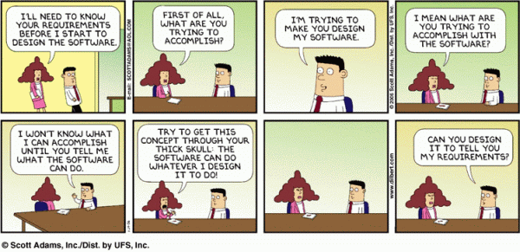
1.2 But requirement is hard to capture
From http://www.ahlsmith.com/?tag=software-requirements
Notes:
skull
US: [skʌl]

Slide 6
There are many different types of requirements at different levels of detail.
The number of requirements can become unmanageable if they're not controlled.
Requirements are related to one another and also to other deliverables of the software engineering process.
Requirements have unique properties or property values. For example, they are not necessarily equally important nor equally easy to meet.
There are many interested parties, which means requirements need to be managed by cross-functional groups of people.
Requirements change.
Notes:
2/3 of finished system errors are requirements and design errors
A careful requirements process doesn’t mean there will be no changes later
Average project experiences about 25% changes in the requirements
This accounts for 70-80% if the rework of the project [Code Complete, p40]
Important to plan for requirements changes
The case of critical applications
Changes in requirements are expensive. Changing the requirements costs:
3 x as much during the design phase
5-10 x as much during implementation
10-100 x as much after release [Code Complete, p30]

Slide 7
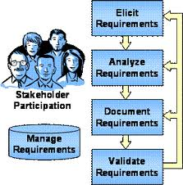
2. Requirements Engineering

Slide 8
A Solution: Requirements Engineering
Builds a bridge from the system requirements into software design and construction
Allows the requirements engineer to examine
the context of the software work to be performed
the specific needs that design and construction must address
the priorities that guide the order in which work is to be completed
the information, function, and behavior that will have a profound impact on the resultant design

Slide 9
Requirements engineering is the branch of software engineering concerned with the real-world goals for, functions of, and constraints on software systems. It is also concerned with the relationship of these factors to precise specifications of software behavior, and to their evolution over time and across software families
Zave, P. (1997). Classification of Research Efforts in Requirements Engineering. ACM Computing Surveys, 29(4): 315-321.

Slide 10
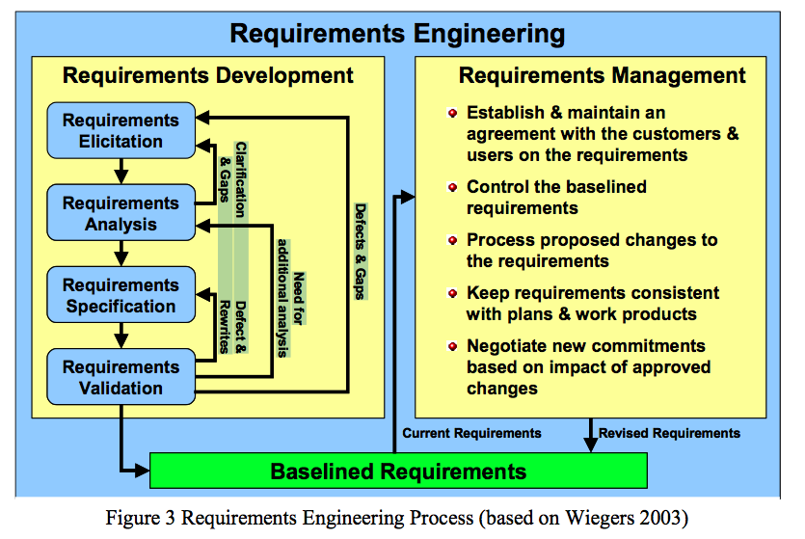

Slide 11
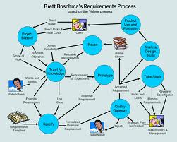
3. Requirement Process

Slide 12
3.1 Software Lifecycle Activities
Requirements
Elicitation
Requirements
Analysis
System
Design
Object
Design
Implemen-
tation
Testing
Implemented
By
Expressed in Terms Of
Structured By
Realized By
Verified
By
class...
class...
class...
?
class....
?
Use Case
Model
Application
Domain
Objects
Implementation Domain
Objects
SubSystems
Source
Code
Test
Cases

Slide 13
First Step in Establishing the Requirements: System Identification
The development of a system is not just done by taking a snapshot of a scene (domain)
Two questions need to be answered:
How can we identify the purpose of a system?
Crucial is the definition of the system boundary: What is inside, what is outside the system?
These two questions are answered in the requirements process
The requirements process consists of two activities:
Requirements Elicitation:
Definition of the system in terms understood by the customer (“Problem Description”)
Requirements Analysis:
Technical specification of the system in terms understood by the developer (“Problem Specification”)
Notes:
The identification of objects and the definition of the system boundary are heavily intertwined with each other.

Slide 14
System and Object identification
Two important problems during requirements engineering and requirements analysis:
Definition of the system purpose
Depending on the purpose of the system, different objects might be found
What object is inside, what object is outside?
How can we identify the purpose of a system?
Scenarios
Use cases: Abstractions of scenarios
Identification of objects

Slide 15
Products of requirements elicitation and analysis
Requirements
Elicitation
system
specification
:Model
Contract with the user
Analysis
analysis model
:Model
(UML activity diagram)

Slide 16
System Specification vs Analysis Model
Both models focus on the requirements from the user’s view of the system.
System specification uses natural language (derived from the problem statement)
The analysis model uses formal or semi-formal notation (for example, a graphical language like UML)
The starting point is the problem statement

Slide 17
Problem Statement
The problem statement is developed by the client as a description of the problem addressed by the system
Other words for problem statement:
Statement of Work
A good problem statement describes
The current situation
The functionality the new system should support
The environment in which the system will be deployed
Deliverables expected by the client
Delivery dates
A set of acceptance criteria

Slide 18

4. Requirements Elicitation

Slide 19
4.1 Requirements Elicitation
Challenging activity
Requires collaboration of people with different backgrounds
User with application domain knowledge
Developer with solution domain knowledge (design knowledge, implementation knowledge)
Bridging the gap between user and developer:
Scenarios: Example of the use of the system in terms of a series of interactions with between the user and the system
Use cases: Abstraction that describes a class of scenarios

Slide 20
4.2 Types of Requirements
Functional requirements: Describe the interactions between the system and its environment independent from implementation
The watch system must display the time based on its location
Nonfunctional requirements: User visible aspects of the system not directly related to functional behavior.
The response time must be less than 1 second
The accuracy must be within a second
The watch must be available 24 hours a day except from 2:00am-2:01am and 3:00am-3:01am
Constraints (“Pseudo requirements”): Imposed by the client or the environment in which the system will operate
The implementation language must be COBOL.
Must interface to the dispatcher system written in 1956.

Slide 21
4.3 What is usually not in the Requirements?
System structure, implementation technology
Development methodology
Development environment
Implementation language
Reusability
It is desirable that none of these above are constrained by the client. Fight for it!

Slide 22
ARENA: The Problem
The Internet has enabled virtual communities
Groups of people sharing common of interests but who have never met each other in person. Such virtual communities can be short lived (e.g people in a chat room or playing a multi player game) or long lived (e.g., subscribers to a mailing list).
Many multi-player computer games now include support for virtual communities.
Players can receive news about game upgrades, new game levels, announce and organize matches, and compare scores.
Currently each game company develops such community support in each individual game.
Each company uses a different infrastructure, different concepts, and provides different levels of support.
This redundancy and inconsistency leads to problems:
High learning curve for players joining a new community,
Game companies need to develop the support from scratch
Advertisers need to contact each individual community separately.

Slide 23
ARENA: The Objectives
Provide a generic infrastructure for operating an ARENA to
Support virtual game communities.
Register new games
Register new players
Organize tournaments
Keeping track of the players scores.
Provide a framework for tournament organizers
to customize the number and sequence of matchers and the accumulation of expert rating points.
Provide a framework for game developers
for developing new games, or for adapting existing games into the ARENA framework.
Provide an infrastructure for advertisers.

Slide 24
Types of Requirements
Functional requirements:
Describe the interactions between the system and its environment independent from implementation
Examples:
An ARENA operator should be able to define a new game.
Nonfunctional requirements:
User visible aspects of the system not directly related to functional behavior.
Examples:
The response time must be less than 1 second
The ARENA server must be available 24 hours a day
Constraints (“Pseudo requirements”):
Imposed by the client or the environment in which the system operates
The implementation language must be Java
ARENA must be able to dynamically interface to existing games provided by other game developers.

Slide 25
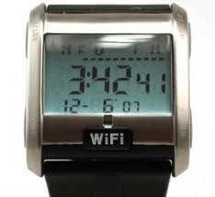
Functional requirements for SatWatch
SatWatch is a wrist watch that displays the time based on its current location. SatWatch uses GPS satellites (Global Positioning System) to determine its location and intemal data structures to convert this location into a time zone. The information stored in the watch and its accuracy measuring time (one hundredth of second uncertainty over five years) is such that the watch owner never needs to reset the time. SatWatch adjusts the time and date displayed as the watch owner crosses time zones and political boundaries (e.g., standard time vs. daylight savings time). For this reason, SatWatch has no buttons or controls available to the user.
SatWatch has a two-line display showing, on the top line, the time (hour, minute, second, time zone) and, on the bottom line, the date (day of the week, day, month, year). The display technology used is such that the watch owner can see the time and date even under poor light conditions.
When a new country or state institutes different rules for daylight savings time, the watch owner may upgrade the software of the watch using the WebifyWatch seria1 device (provided when the watch is purchased) and a personal computer connected to the Intemet. SatWatch complies with the physical, electrical, and software interfaces defined by WebifyWatch API 2.0.

Slide 26
Nonfunctional requirements for SatWatch
SatWatch determines its location using GPS satellites, and as such, suffers from the same limitations as all other GPS devices (e.g., ~100 feet accuracy, inability to determine location at certain times of the day in mountainous regions). During blackout period, SatWatch assumes that it does not cross a time zone or a political boundary. SatWatch corrects its time zone as soon as a blackout period ends.
The battery life of SatWatch is limited to 5 years, which is the estimated life cycle of the housing of SatWatch. The SatWatch housing is not designed to be opened once manufactured, preventing battery replacement and repairs. Instead, SatWatch is priced such that the watch owner is expected to buy a new SatWatch to replace a defective or old SatWatch.

Slide 27
Pseudorequirement for SatWatch
Al1 related software associated with SatWatch, including the onboard software, will be written using Java, to comply with current company policy.

Slide 28
4.4 Requirements Validation
Critical step in the development process,
Usually after requirements engineering or requirements analysis. Also at delivery
Requirements validation criteria:
Correctness:
The requirements represent the client’s view.
Completeness:
All possible scenarios through the system are described, including exceptional behavior by the user or the system
Consistency:
There are functional or nonfunctional requirements that contradict each other
Clarity:
There are no ambiguities in the requirements.
Realism:
Requirements can be implemented and delivered
Traceability:
Each system function can be traced to a corresponding set of functional requirements

Slide 29
Types of Requirements Elicitation
Greenfield Engineering
Development starts from scratch, no prior system exists, the requirements are extracted from the end users and the client
Triggered by user needs
Example: Develop a game from scratch: Asteroids
Re-engineering
Re-design and/or re-implementation of an existing system using newer technology
Triggered by technology enabler
Example: Reengineering an existing game
Interface Engineering
Provide the services of an existing system in a new environment
Triggered by technology enabler or new market needs
Example: Interface to an existing game (Bumpers)

Slide 30

5. Use-Case

Slide 31
5.1 Goals and Stories
Human action is primarily driven by goals.
For a library information system, some goals are like:
Every book request will eventually be fulfilled
The new system will be highly reliable
They try to achieve them by doing some things and by avoiding (i.e. not doing) other things.
Systems are constructed with some goals in mind.

Slide 32
To capture goals is not easy
What is truly needed
Different levels of detail
Uncontrollable Sophistication
Many methods exists
The simple ones are widely applies
Recording functional requirements by writing stories of using a system to help fulfill various stakeholder goals-cases of use

Slide 33
5.2 What is a Use Case?
Created by Ivar Jacobson (1994)
“A use case is a sequence of transactions in a system whose task is to yield a measurable value to an individual actor of the system”
Describes WHAT the system (as a “Black Box”) does from a user’s (actor) perspective
The Use Case Model is NOT an inherently object oriented modeling technique

Slide 34
5.3 Why Use Cases?
Comprehensible by the user
Use cases model a system from the users’ point of view (functional requirements)
Define every possible event flow through the system
Description of interaction between objects
Great tools to manage a project. Use cases can form basis for whole development process
User manual
System design and object design
Implementation
Test specification
Client acceptance test
An excellent basis for incremental & iterative development
Use cases have also been proposed for business process reengineering (Ivar Jacobson)

Slide 35
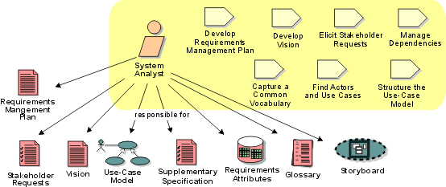
6. Use-case based Requirements Elicitation

Slide 36
6.1Requirements Elicitation Activities
Identify actors
Identify scenarios
Identify use cases
Identify relationships among use cases
Refine use cases
Identify nonfunctional requirements
Identify participating objects

Slide 37
6.2 Identifying actors
Actors represent external entities that interact with the system
An actor can be an human or an external system
Actors in the SatWatch example:
Watch owner
GPS satellites
WebifyWatch serial device

Slide 38
6.3 Scenarios
“A narrative description of what people do and experience as they try to make use of computer systems and applications” [M. Carrol, Scenario-based Design, Wiley, 1995]
A concrete, focused, informal description of a single feature of the system used by a single actor.
Scenarios can have many different uses during the software lifecycle

Slide 39
Scenario Example: Warehouse on Fire
Bob, driving down main street in his patrol car notices smoke coming out of a warehouse. His partner, Alice, reports the emergency from her car.
Alice enters the address of the building, a brief description of its location (i.e., north west corner), and an emergency level. In addition to a fire unit, she requests several paramedic units on the scene given that area appear to be relatively busy. She confirms her input and waits for an acknowledgment.
John, the Dispatcher, is alerted to the emergency by a beep of his workstation. He reviews the information submitted by Alice and acknowledges the report. He allocates a fire unit and two paramedic units to the Incident site and sends their estimated arrival time (ETA) to Alice.
Alice received the acknowledgment and the ETA.

Slide 40
Documentation schema for the scenario
Scenario name: warehouse0nFire
Participating actor instances:
bob, alice : FieldOfficer
john: Dispatcher
Flow of events :
Bob, driving down main street in his patrol car notices smoke coming out of a warehouse. His partner, Alice, activates the “Report Emergency” function from her FRIEND laptop.
Alice enters the address of the building, a brief description of its location (i.e., northwest corner), and an emergency level. In addition to a fire unit, she requests severa1 paramedic units on the scene, given that the area appears to be relatively busy. She confirms her input and waits for an acknowledgment.
John, the Dispatcher , is alerted to the emergency by a beep of his workstation. He reviews the information submitted by Alice and acknowledges the report. He creates allocates a fire unit and two paramedic units to the Incident site and sends their estimated arrival time (ETA) to Alice.
Alice receives the acknowledgment and the ETA.

Slide 41
Types of Scenarios
As-is scenario
Used in describing a current situation. Usually used during re-engineering. The user describes the system.
Visionary scenario
Used to describe a future system. Usually described in greenfield engineering or reengineering.
Can often not be done by the user or developer alone
Evaluation scenario
User tasks against which the system is to be evaluated
Training scenario
Step by step instructions designed to guide a novice user through a system

Slide 42
Heuristics for finding Scenarios
Ask yourself or the client the following questions:
What are the primary tasks that the system needs to perform?
What data will the actor create, store, change, remove or add in the system?
What external changes does the system need to know about?
What changes or events will the actor of the system need to be informed about?
Insist on task observation if the system already exists (interface engineering or reengineering)
Ask to speak to the end user, not just to the software contractor
Expect resistance and try to overcome it

Slide 43
How do we find scenarios?
Don’t expect the client to be verbal if the system does not exist (greenfield engineering)
Don’t wait for information even if the system exists
Engage in a dialectic approach (evolutionary, incremental)
You help the client to formulate the requirements
The client helps you to understand the requirements
The requirements evolve while the scenarios are being developed
Notes:
1. a method used in philosophy to try to discover truth by considering ideas together with opposite ideas

Slide 44
Example: Accident Management System
What needs to be done to report a “Cat in a Tree” incident?
What do you need to do if a person reports “Warehouse on Fire?”
Who is involved in reporting an incident?
What does the system do if no police cars are available? If the police car has an accident on the way to the “cat in a tree” incident?
What do you need to do if the “Cat in the Tree” turns into a “Grandma has fallen from the Ladder”?
Can the system cope with a simultaneous incident report “Warehouse on Fire?”

Slide 45
Observations about Warehouse on Fire Scenario
Concrete scenario
Describes a single instance of reporting a fire incident.
Does not describe all possible situations in which a fire can be reported.
Participating actors
Bob, Alice and John

Slide 46
6.4 Use Cases
A use case is a flow of events in the system, including interaction with actors
It is initiated by an actor
Each use case has a name
Each use case has a termination condition
Graphical Notation: An oval with the name of the use case
ReportEmergency
Use Case Model: The set of all use cases specifying the complete functionality of the system

Slide 47
Example: Use Case Model for Incident Management
FieldOf
Dispatcher
f
icer
OpenIncident
ReportEmergency
AllocateResources

Slide 48
Next goal, after the scenarios are formulated:
Find a use case in the scenario that specifies all possible instances of how to report a fire
Example: “Report Emergency “ in the first paragraph of the scenario is a candidate for a use case
Describe this use case in more detail
Describe the entry condition
Describe the flow of events
Describe the exit condition
Describe exceptions
Describe special requirements (constraints, nonfunctional requirements)

Slide 49
Example of steps in formulating a use case
First name the use case
Use case name: ReportEmergency
Then find the actors
Generalize the concrete names (“Bob”) to participating actors (“Field officer”)
Participating Actors:
Field Officer (Bob and Alice in the Scenario)
Dispatcher (John in the Scenario)
?
Then concentrate on the flow of events
Use informal natural language

Slide 50
Example of steps in formulating a use case
Formulate the Flow of Events:
The FieldOfficer activates the “Report Emergency” function on her terminal. FRIEND responds by presenting a form to the officer.
The FieldOfficer fills the form, by selecting the emergency level, type, location, and brief description of the situation. The FieldOfficer also describes possible responses to the emergency situation. Once the form is completed, the FieldOfficer submits the form, at which point, the Dispatcher is notified.
The Dispatcher reviews the submitted information and creates an Incident in the database by invoking the OpenIncident use case. The Dispatcher selects a response and acknowledges the emergency report.
The FieldOfficer receives the acknowledgment and the selected response.

Slide 51
Example of steps in formulating a use case
Write down the exceptions:
The FieldOfficer is notified immediately if the connection between her terminal and the central is lost.
The Dispatcher is notified immediately if the connection between any logged in FieldOfficer and the central is lost.
Identify and write down any special requirements:
The FieldOfficer’s report is acknowledged within 30 seconds.
The selected response arrives no later than 30 seconds after it is sent by the Dispatcher.
Exceptions: “extend” use cases

Slide 52
How to Specify a Use Case (Summary)
Name of Use Case
Actors
Description of actors involved in use case
Entry condition
Use a syntactic phrase such as “This use case starts when…”
Flow of Events
Free form, informal natural language
Exit condition
Star with “This use cases terminates when…”
Exceptions
Describe what happens if things go wrong
Special Requirements
List nonfunctional requirements and constraints

Slide 53
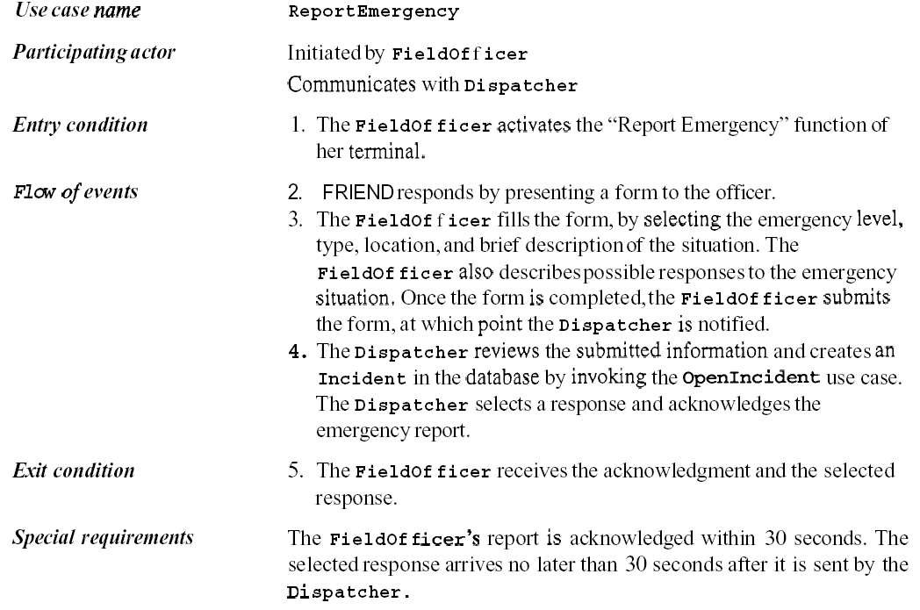
The ReportEmergency use case

Slide 54
Use Case Associations
Use case association = relationship between use cases
Important types:
Extends
A use case extends another use case
Include
A use case uses another use case (“functional decomposition”)
Generalization
An abstract use case has different specializations
Do not use other kinds of association

Slide 55
<<Include>>: Functional Decomposition
Problem:
A function in the original problem statement is too complex to be solvable immediately
Solution:
Describe the function as the aggregation of a set of simpler functions. The associated use case is decomposed into smaller use cases
CreateDocument
<<include>>
<<include>>
<<include>>
Scan
OCR
Check

Slide 56
<<Include>>: Reuse of Existing Functionality
Problem:
There are already existing functions. How can we reuse them?
Solution:
The include association from a use case A to a use case B indicates that an instance of the use case A performs all the behavior described in the use case B (“A delegates to B”)
Example:
The use case “ViewMap” describes behavior that can be used by the use case “OpenIncident” (“ViewMap” is factored out)
Note: The base case cannot exist alone. It is always called with the supplier use case
<<include>>
OpenIncident
Base Use
Case
ViewMap
<<include>>
Supplier
Use Case
AllocateResources

Slide 57
<Extend>> Association for Use Cases
Problem:
The functionality in the original problem statement needs to be extended.
Solution:
An extend association from a use case A to a use case B indicates that use case B is an extension of use case A.
Example:
The use case “ReportEmergency” is complete by itself , but can be extended by the use case “Help” for a specific scenario in which the user requires help
Note: In an extend assocation, the base use case can be executed without the use case extension
Help
FieldOfficer
<<extend>>
ReportEmergency

Slide 58
Generalization association in use cases
Problem:
You have common behavior among use cases and want to factor this out.
Solution:
The generalization association among use cases factors out common behavior. The child use cases inherit the behavior and meaning of the parent use case and add or override some behavior.
Example:
Consider the use case “ValidateUser”, responsible for verifying the identity of the user. The customer might require two realizations: “CheckPassword” and “CheckFingerprint”
CheckPassword
Parent
Case
ValidateUser
Child
Use Case
CheckFingerprint

Slide 59
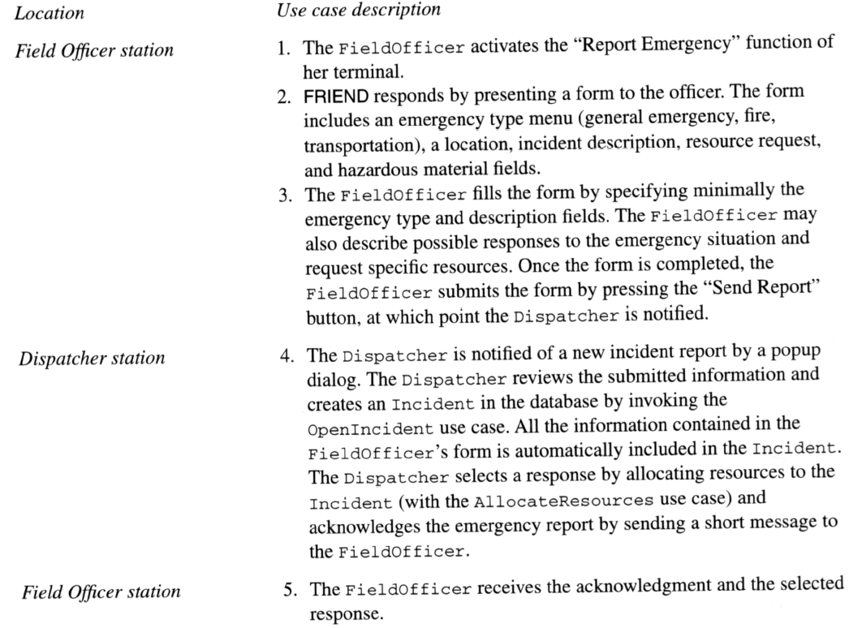
Refining the ReportEmergency use case flow of events

Slide 60
How do I find use cases?
Select a narrow vertical slice of the system (i.e. one scenario)
Discuss it in detail with the user to understand the user’s preferred style of interaction
Select a horizontal slice (i.e. many scenarios) to define the scope of the system.
Discuss the scope with the user
Use mock-ups as visual support
Find out what the user does
Task observation (Good)
Questionnaires (Bad)

Slide 61
From Use Cases to Objects
Le
v
el 1
Top Level Use Case
Le
Level 2 Use Cases
v
el 2
Le
v
el 2
Le
Level 3 Use Cases
v
Le
el 3
v
el 3
Le
v
el 3
Le
Operations
v
el 4
Le
v
el 4
A
B
Participating
Objects

Slide 62
Abbott’s technique for mapping parts of speech to model components
Part of speech | Model Component | Examples
Proper noun | Object | Alice
Common noun | Class | FieldOfficer
Doing verb | Operation | Creates, submits, selects
Being verb | Inheritance | Is a kind of, is one of either
Having verb | Aggregation | Has, consists of, includes
Modal verb | Constraints | Must be
Adjective | Attribute | Incident description
Notes:
Proper noun, 专有名词
Common noun, 普通名词
Modal verb，助动词
Adjective, 形容词

Slide 63
Finding Participating Objects in Use Cases
For any use case do the following
Find terms that developers or users need to clarify in order to understand the flow of events
Always start with the user’s terms, then negotiate:
FieldOfficerStationBoundary or FieldOfficerStation?
IncidentBoundary or IncidentForm?
EOPControl or EOP?
Identify real world entities that the system needs to keep track of. Examples: FieldOfficer, Dispatcher, Resource
Identify real world procedures that the system needs to keep track of. Example: EmergencyOperationsPlan
Identify data sources or sinks. Example: Printer
Identify interface artifacts. Example: PoliceStation
Do textual analysis to find additional objects (Use Abott’s technique)
Model the flow of events with a sequence diagram

Slide 64
Summary
In this lecture, we reviewed the requirements elicitation activities aimed at defining the boundary of the system:
Scenario identification
Use case identification and refinement
Identification of participating objects
Requirements elicitation is to build a functional model of the system which will then be used during analysis to build an object model and a dynamic model.

Slide 65
Thanks cao-jian@sjtu.edu.cn
Some materials come from Bernd Bruegge’s PPT, others from Internet

